Slide 1


TEACHMATE
A College Portal: A Full-Stack Classroom Management System
Revolutionizing education through a centralized, intuitive, and secure platform for instructors and students.

Slide 2
TEACHMATE
MEMBERS
ADARSH MANI TIWARI - 24BCE01923
ANUKARSH TIWARI - 24BCE10166
KARTIKEY SINGH - 24BCE11116
RIYA - 24BCE10921
TANYA GUPTA - 24BCE11012

Slide 3
Project Overview: Streamlining the Classroom Experience
Problem Statement
Objective
Scope
Traditional classroom management is fragmented, relying on multiple platforms for materials, assignments, and grades. This leads to inefficiency, confusion, and a lack of a centralized record, hindering effective learning and teaching.
Our goal is to design and build a centralized, secure, and role-based web portal. This system will streamline the entire classroom lifecycle, offering a cohesive experience for both teachers and students.
This project focuses on core functionalities: robust user authentication, intuitive class management, efficient material distribution, simplified assignment submission, and transparent grading processes.

Slide 4


Essential Requirements for Development
Software Ecosystem
Hardware Necessities
Development Machine: A modern computer (laptop or desktop) with sufficient processing power and memory for coding and testing.
Operating System: Flexibility across Windows, macOS, or Linux environments.
Backend Runtime: Node.js (v14 or higher) paired with the Express.js framework for robust server-side logic.
Deployment Server: A dedicated server for hosting, ideally a cloud-based Virtual Private Server (VPS) for scalability and reliability.
Database Management: MySQL, a powerful relational database system.
Frontend Access: Any modern web browser (Chrome, Firefox, Safari) for optimal user experience.
Development Toolkit: Visual Studio Code for coding, Git for version control and collaborative development.

Slide 5
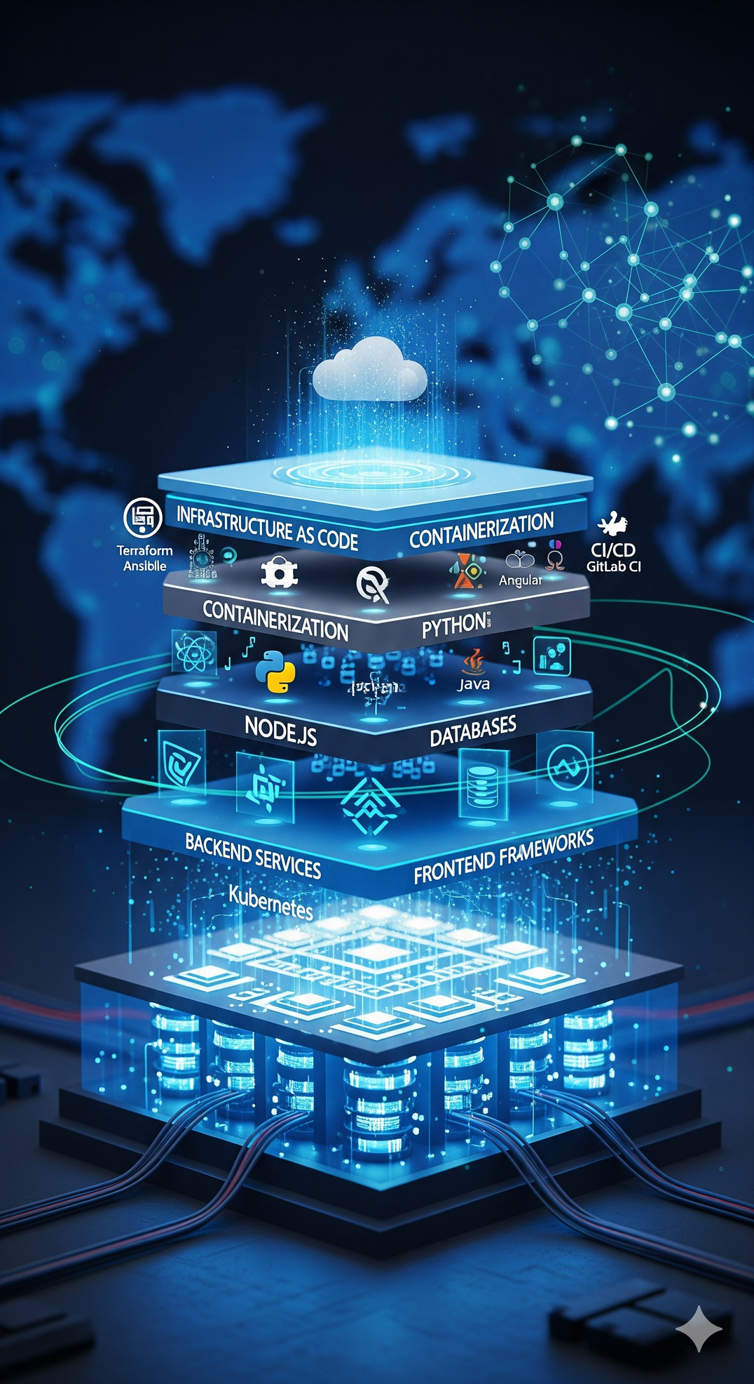

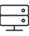


Tech Stack -:
Frontend
HTML5: Provides the structural foundation for all web pages.
Bootstrap 5: Enables a responsive, mobile-first user interface with pre-built components.
Vanilla JavaScript: Powers dynamic client-side logic and handles asynchronous API calls for a smooth user experience.
Backend
Node.js: The JavaScript runtime environment executing server-side code efficiently.
Express.js: A minimalist web application framework providing robust features for web and mobile applications.
Database
MySQL: A highly reliable and scalable relational database system ensuring data persistence and integrity.
Key Libraries
mysql2: Efficient database connectivity.
express-session: Secure and scalable session management.
bcrypt: Robust password hashing for enhanced security.
multer: Handles multipart/form-data, primarily for file uploads.

Slide 6
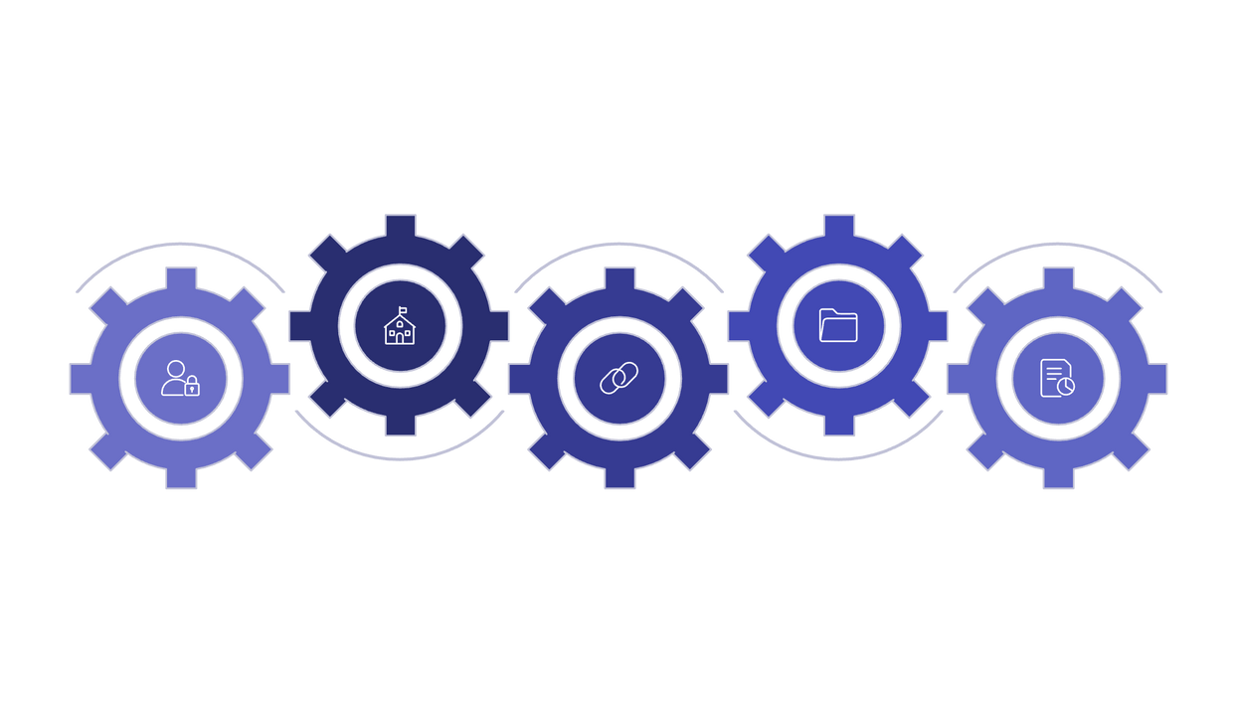





Database Schema: The Backbone of Our Data
The relational database schema is meticulously designed to support all core functionalities, establishing clear relationships between entities.
Classes
Materials
ID, name, join_code, teacher_id
ID, class_id, title, file_path
Users
Enrollments
Assignments
ID, username, password_hash, role
ID, user_id, class_id (many-to-many)
ID, class_id, title, due_date
This structured approach ensures data integrity and enables efficient querying for both teacher and student workflows, forming a robust foundation for the portal.

Slide 7
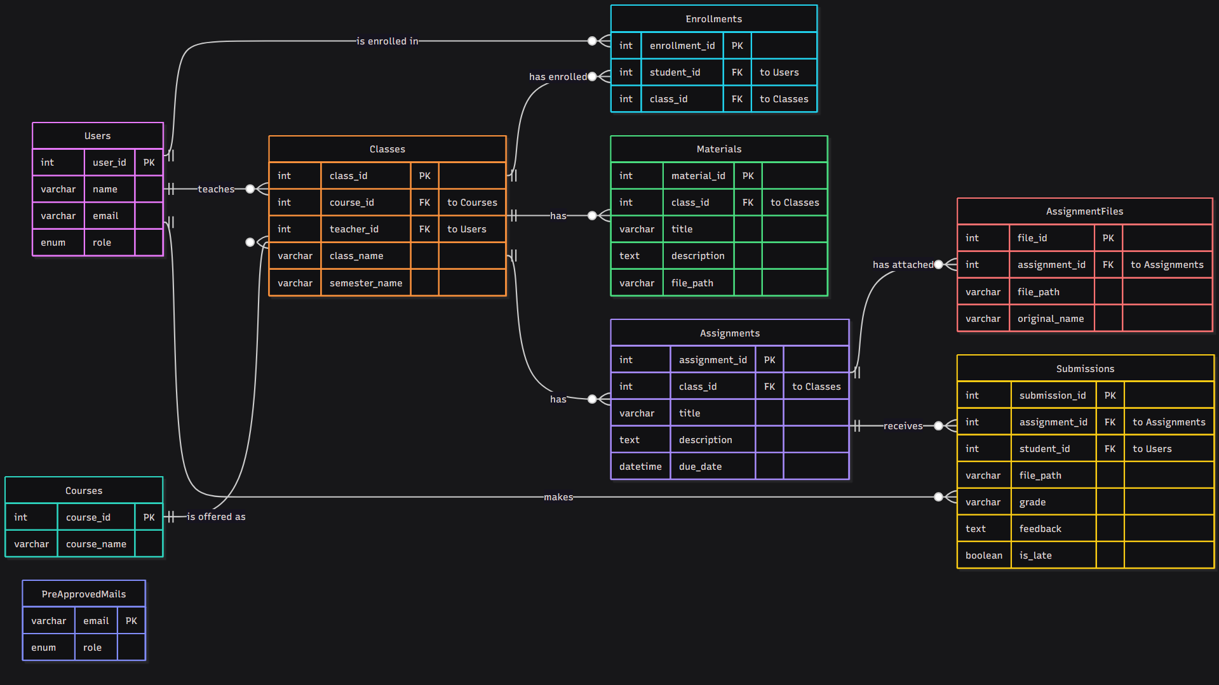

Slide 8



The Teacher Workflow – Part 1
Our platform is meticulously designed to empower educators, streamlining their daily tasks with an intuitive and secure interface. This first part highlights key functionalities for class management and content delivery.
Secure Teacher Dashboard
Full Class Lifecycle Management
Seamless Content Management
Teachers land on a personalised dashboard, displaying only the classes they have meticulously created, ensuring privacy and ease of navigation. All data is protected with robust security protocols.
Educators can effortlessly create new classes, which generates a unique join code for students. They can also delete classes, triggering a complete and secure cascading deletion of all associated data.
Within each class, teachers can upload multiple study materials and view a comprehensive roster of all enrolled students. This feature facilitates organised learning environments.
This foundational module ensures teachers have complete control and visibility over their digital classrooms, fostering an efficient teaching ecosystem.

Slide 9





The Teacher Workflow – Part 2
Continuing with the teacher's journey, this segment focuses on the comprehensive tools available for assignment management, submission review, and providing valuable student feedback.
Intuitive Assignment Creation
Organised Submission Review
Effortless Grading & Feedback
Teachers can craft detailed assignments, setting precise due dates and times. They can also attach multiple files, such as question PDFs or supplementary resources, ensuring clarity for students.
All student submissions for an assignment are presented in a well-organised table. Late submissions are clearly flagged, enabling teachers to quickly identify and manage overdue work.
Educators can enter grades and detailed written feedback for each submission instantly. This process is seamless, with data saving without any page reload, enhancing efficiency.
These features collectively empower teachers to manage coursework effectively, from distribution to evaluation, ensuring a smooth academic workflow.

Slide 10
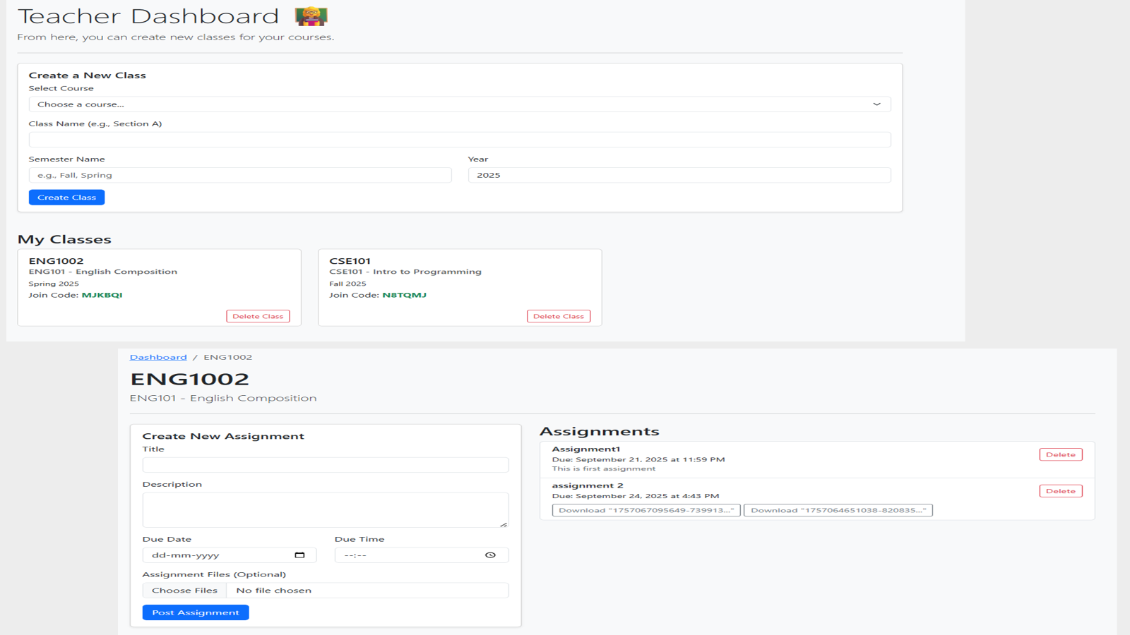

Slide 11
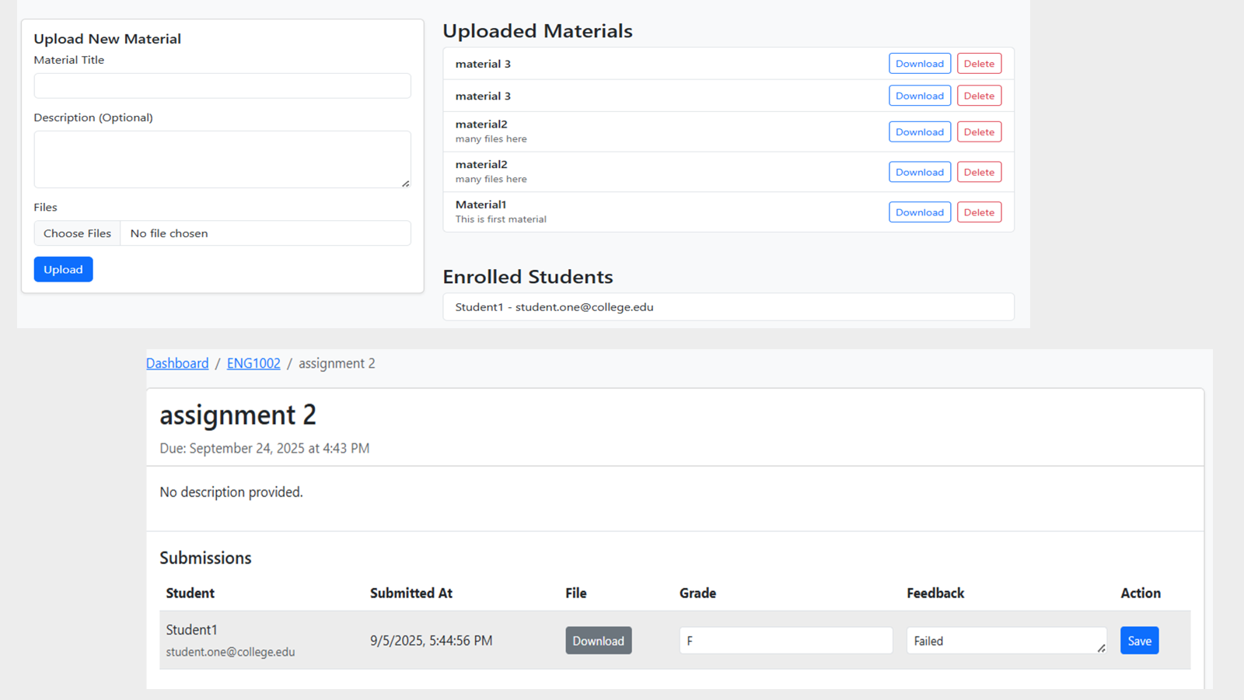

Slide 12
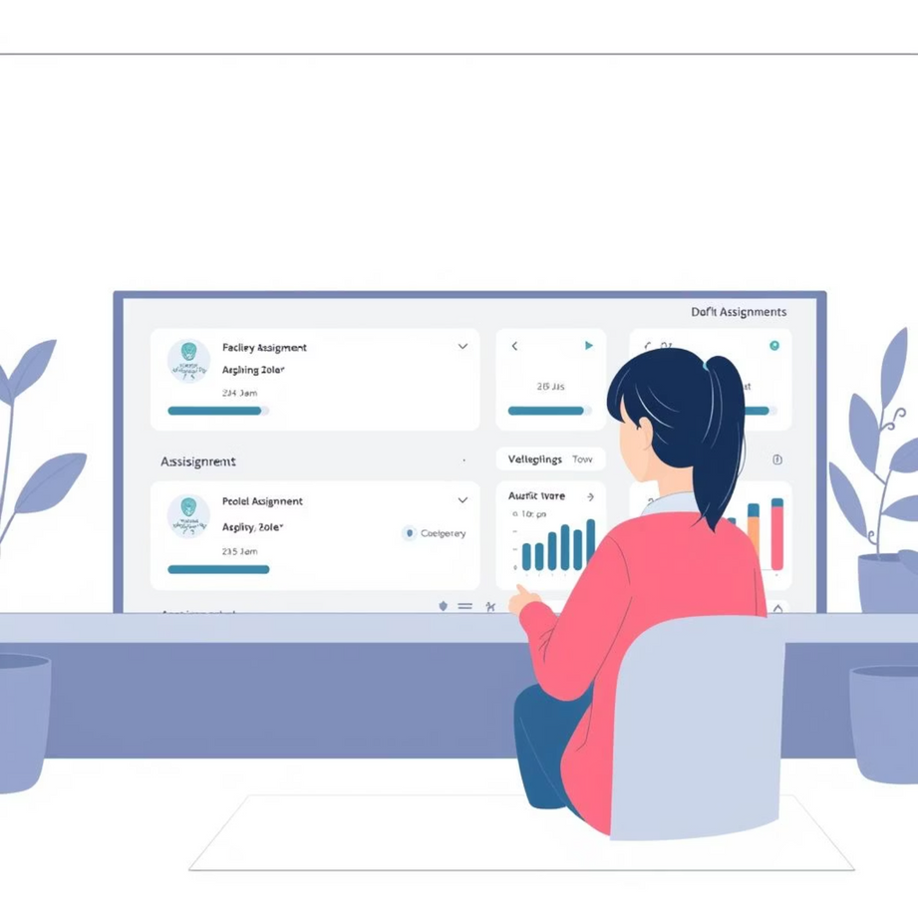
The Student Workflow
Our platform is designed to offer students a streamlined, intuitive experience, ensuring easy access to their academic responsibilities and learning materials.
The student experience is centered around accessibility and simplicity:
Personalised Student Dashboard
The student's initial view is a dynamic dashboard, prominently featuring a clear list of all their upcoming assignments from every enrolled class, neatly sorted by their due dates.
Simple & Quick Onboarding
Students can effortlessly join new classes by simply entering the unique class code provided by their teacher, making enrolment swift and hassle-free.
Accessible Content Viewing
Within their classes, students can easily navigate to view and download all assigned study materials and assignment files, ensuring they always have the necessary resources.

Slide 13
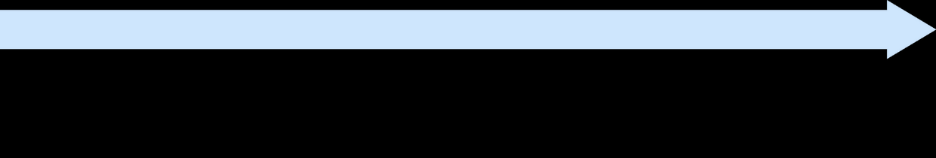


Submissions & Grades
The platform provides a robust system for students to submit their work and, crucially, to receive comprehensive feedback and grades from their teachers, completing the learning cycle.
Simplified Submission System
Closing the Feedback Loop
Students utilise an easy-to-use form to upload their coursework for any assignment. The backend intelligently checks if the submission is late, providing transparency for both students and teachers.
After a teacher has evaluated and graded their work, students can effortlessly return to the specific assignment page. Here, they can view their final grade and access the teacher's detailed feedback.

Slide 14
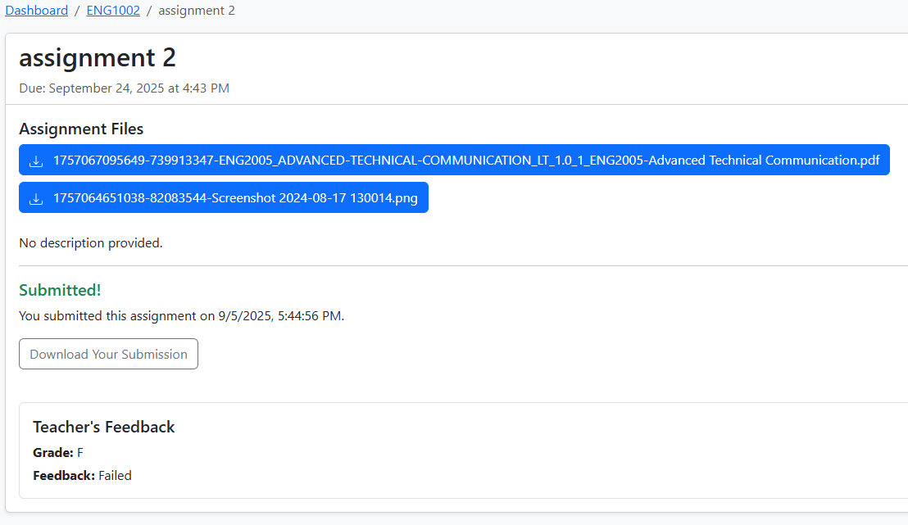
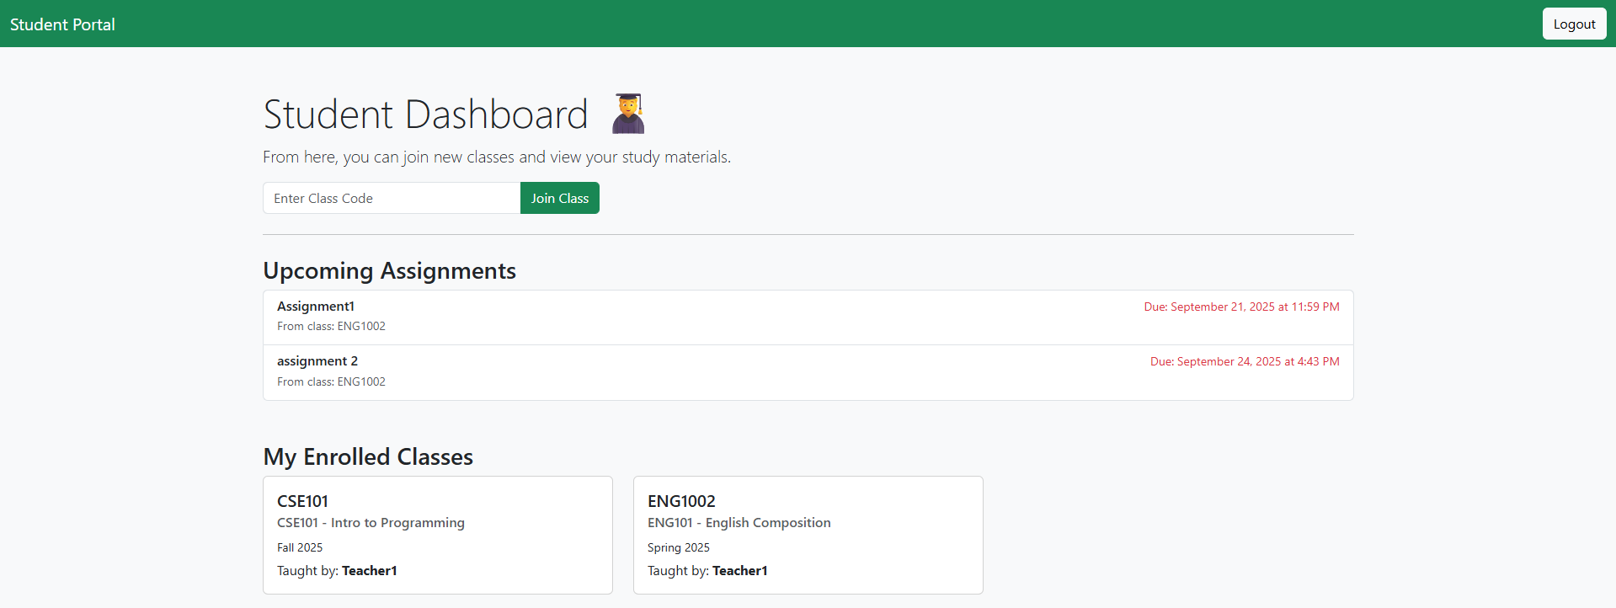
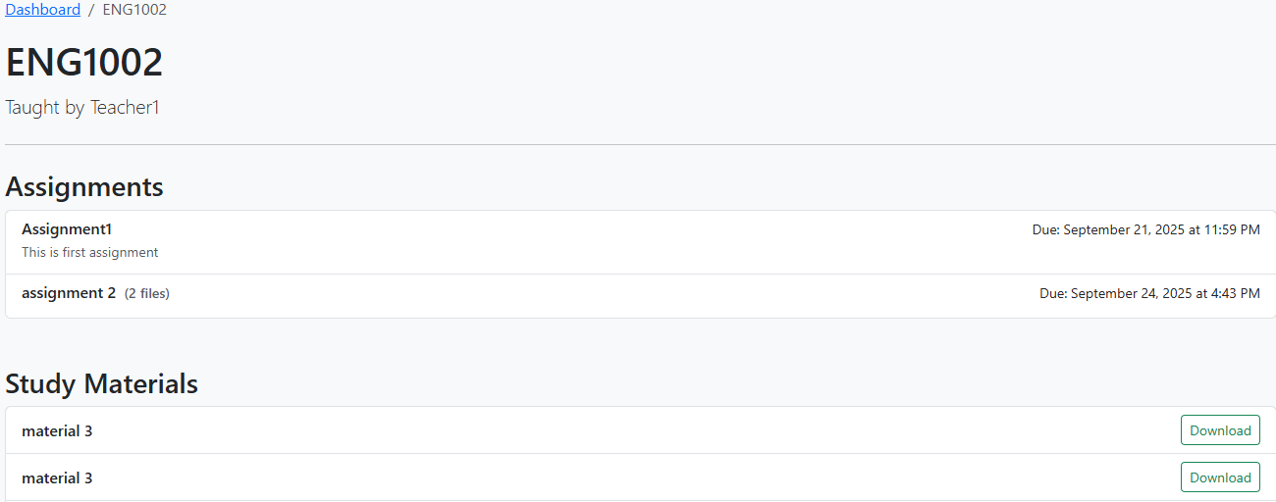

Slide 15


